Slide 1
Capstone 1 - HR Employee Attrition Analysis
Cerlin Immaculate A
Tools: Python | MySQL | Power BI
GitHub: github.com/CERLINIMMACULATEA/Capstone1_HR_Attrition_Cerlin

Slide 2
Business Problem
Problem: Attrition Rate 16.12% (237 of 1470 left).
Impact: High hiring cost, productivity loss.
User: HR Manager & Dept Heads need to know WHY.
Objective: Find Top 3 Root Causes + Give 3 Actionable Solutions.

Slide 3
Dataset
Source: IBM HR Analytics - Kaggle (Link on slide).
Size: 1470 Rows x 35 Columns.
Row Meaning: 1 Row = 1 Employee.
Key Fields: Age, Department, Monthly Income, OverTime, Job Satisfaction (1-4), Attrition (Yes/No).

Slide 4
Project Workflow - Pattern 1
Pattern 1: Python -> MySQL -> Power BI.
Python (Pandas): Cleaning + EDA.
MySQL: 10 Business Questions (GROUP BY, CASE WHEN).
Power BI: Star Schema + DAX + Interactive Dashboard.
Why 3 Tools? Cleaning in Pandas, Fast Questions in SQL, Story in Dashboard.

Slide 5
Data Cleaning
Before: Raw CSV with text values
Checks: Duplicates = 0 | Missing Values = 0
Fixed: OverTime Yes/No -> 1/0 using map()
Created: Age Groups, Income Slabs
After: Cleaned CSV - 1470 rows ready (HR_Attrition_Cleaned.csv)
Challenge: Text to number conversion - Solved with Pandas map()

Slide 6
SQL Analysis
Q1 Dept wise Attrition: Sales 20.6% (92/446) - HIGHEST
Q2 OverTime: Yes 30.5% (127/416) vs No 10.4% (110/1054) - 3X Difference
Q3 Hike + Satisfaction: Low Satisfaction (1) + 11% Hike = 22.5% (9/40) vs High (4) = 11.3% (52/459)
Full 10 Queries in GitHub: HR_Attrition_Analysis_Cerlin.sql

Slide 7
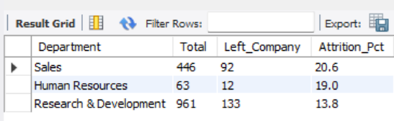
Q1 Output : Dept Wise - Sales 20.6% HIGHEST

Slide 8
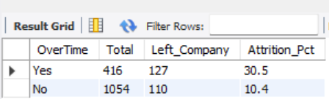
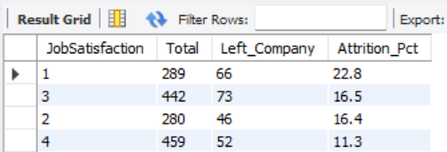
Q2 Output : OverTime - Yes 30.5% (127/416) HIGHEST vs No 10.4% (110/1054)
Q3 Output : Job Satisfaction - Low (1) 22.8% (66/289) HIGHEST vs High (4) 11.3% (52/459)

Slide 9
Data Model - Star Schema
Fact Table
• Fact_Employee - 1470 Rows
• Core Metrics: Attrition, Age, Monthly Income
Dimension Tables
• Dim_Dept → Department, Job Role
• Dim_Education → Education, Education Field
• Dim_Personal → Gender, Marital Status, AgeBand
Relationships
• Dim (1) - Fact (Many)
• Dim_Dept - Fact_Employee
DAX Measures
• Total Employee Count = COUNTROWS(Fact_Employee)
• Attrition Count = CALCULATE(COUNTROWS(...), [Attrition]=”Yes”)
• Attrition % = DIVIDE([Attrition Count], [Total Emp Count])

Slide 10
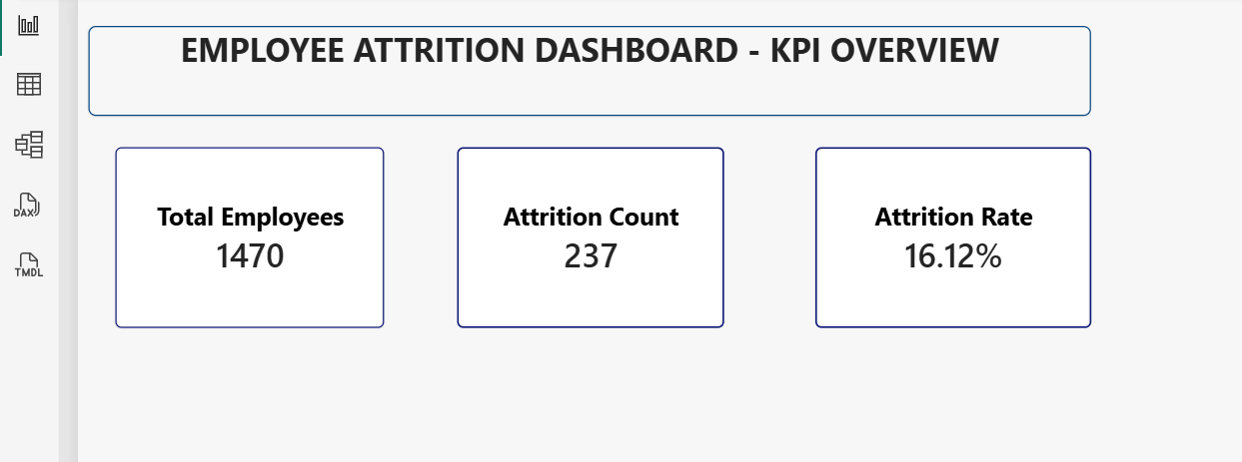
Dashboard Implementation - KPI Overview

Slide 11
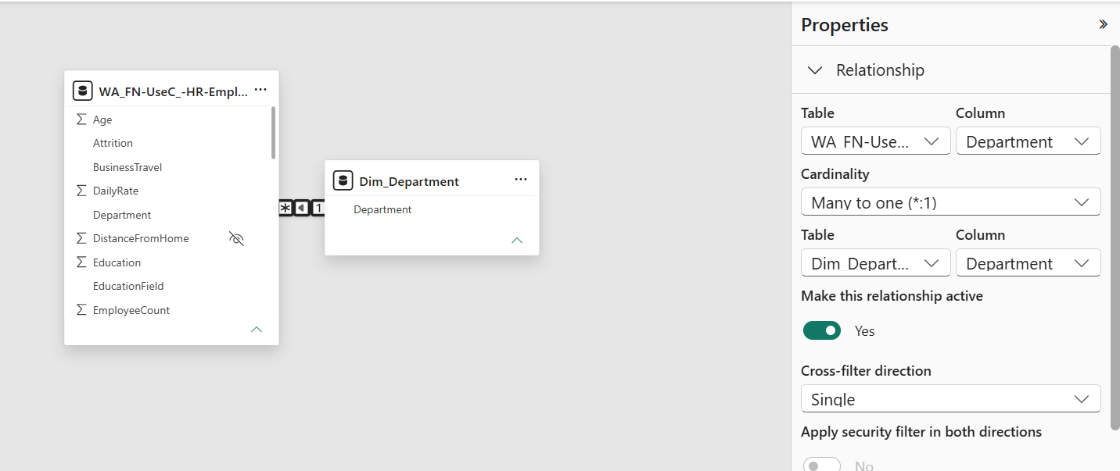
Data Model Implementation - Relationship View

Slide 12
Key Insights
Point 1: Overtime = High Attrition (You proved in Q2 - 30.5%).
Point 2: Low Satisfaction + Low Hike = 22.5% Attrition (You proved in Q3).
Point 3: Age 25-34 = Highest Attrition (18.5%) & Sales Dept = 20.8% Attrition.

Slide 13
Recommendations to HR
1. Control Overtime: High overtime = High attrition. Introduce flexible hours & comp-off.
2. Retain New & Low-Income Staff: Focus on 0-2 years tenure group with salary review & clear growth path.
3. Support Sales Team: Revise targets and improve incentive structure for Sales department.
4. Boost Engagement: Launch mentorship & engagement programs for younger, single employees.

Slide 14
Conclusion
The organization has an overall attrition rate of 16.12% (237 of 1470 employees), indicating a critical retention issue.
Key attrition drivers identified are excessive overtime, low monthly income, early tenure (0-2 years), and high pressure in the Sales department.
Single and younger employees (18-30 years) are found to be the most vulnerable group.
Implementing the proposed targeted HR interventions will help improve retention, reduce hiring costs, and enhance overall workforce stability.

Slide 15


